Slide 1

Employee Attrition
- Shraddha Sharma

Slide 2
Introduction
At XYZ company, we're tackling high attrition rates head-on. By partnering with an HR analytics consultancy, we're digging deep into why employees are leaving. As the lead HR analyst, my mission is to craft a powerful dashboard fueled by data insights. Our goal to arm XYZ with smart decisions that cut attrition and boost retention. By pinpointing what drives departures, we'll serve up actionable advice to fortify our workforce and up our game. Join us on this data-driven journey to build a happier, more committed team at XYZ company.

Slide 3

KPI’s
EMPLOYEE COUNT – 4,410
ATTRITION COUNT - 771
ATTRITION RATE – 16.12%
ACTIVE EMPLOYEES – 3,699
AVG. AGE - 37

Slide 4
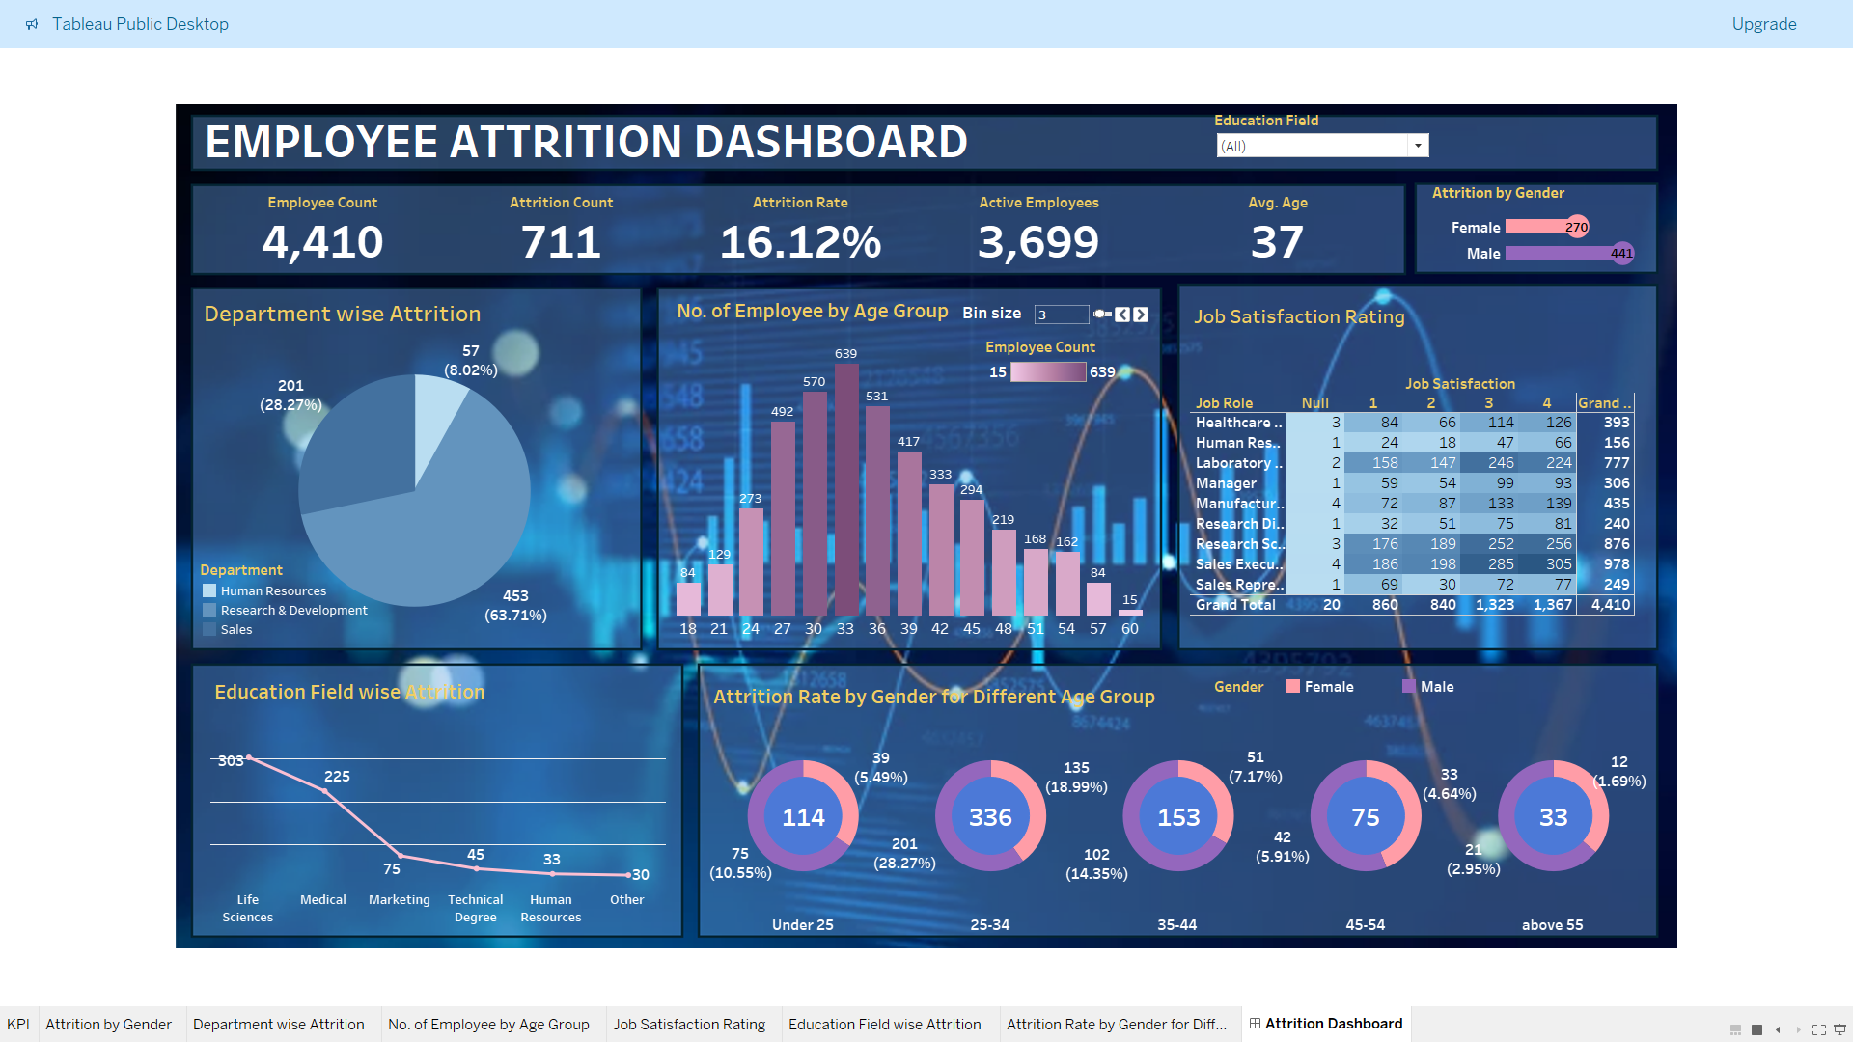
Dashboard

Slide 5
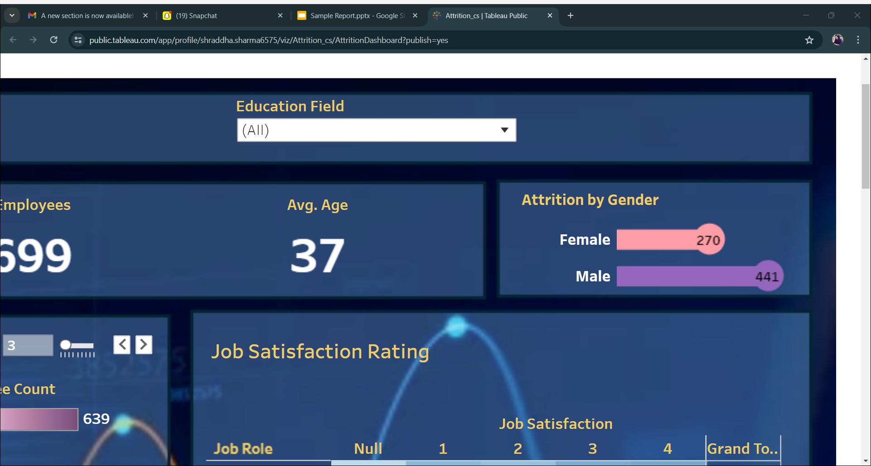
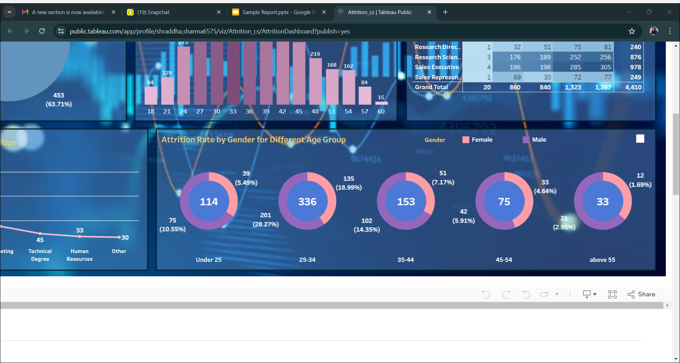
Gender and age wise attrition

Slide 6
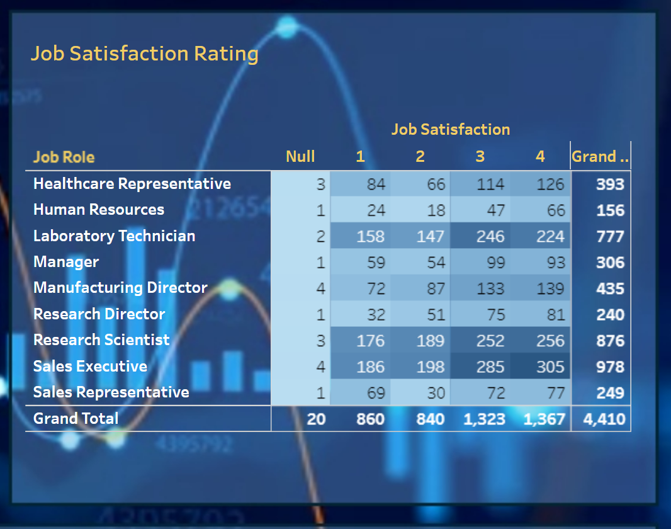
JOB ROLE WISE JOB SATISFACTION RATING

Slide 7
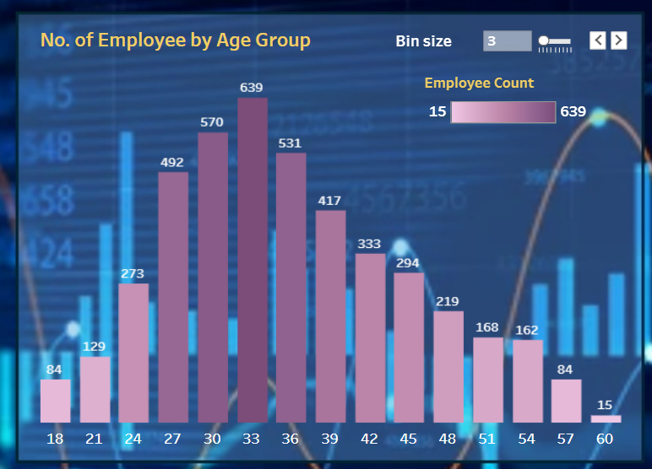
NUMBER OF EMPLOYEE BY AGE GROUP

Slide 8
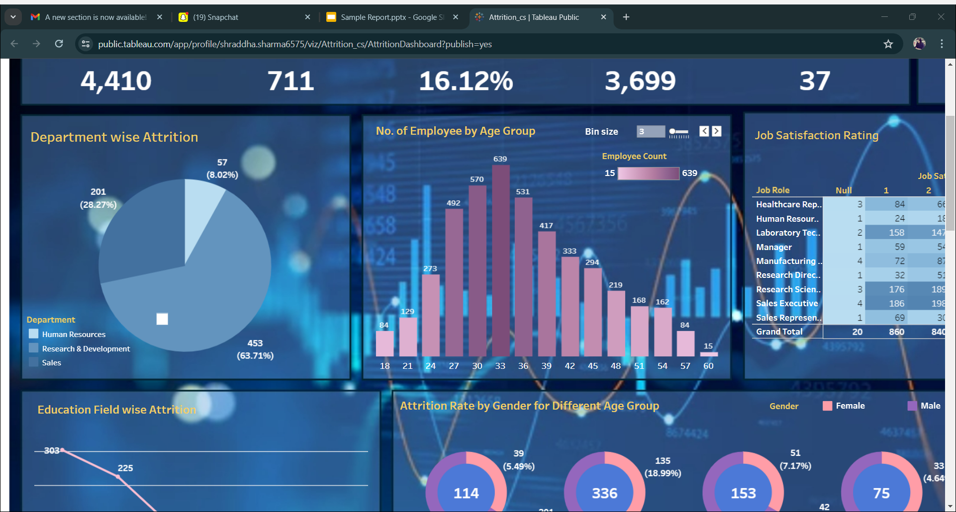
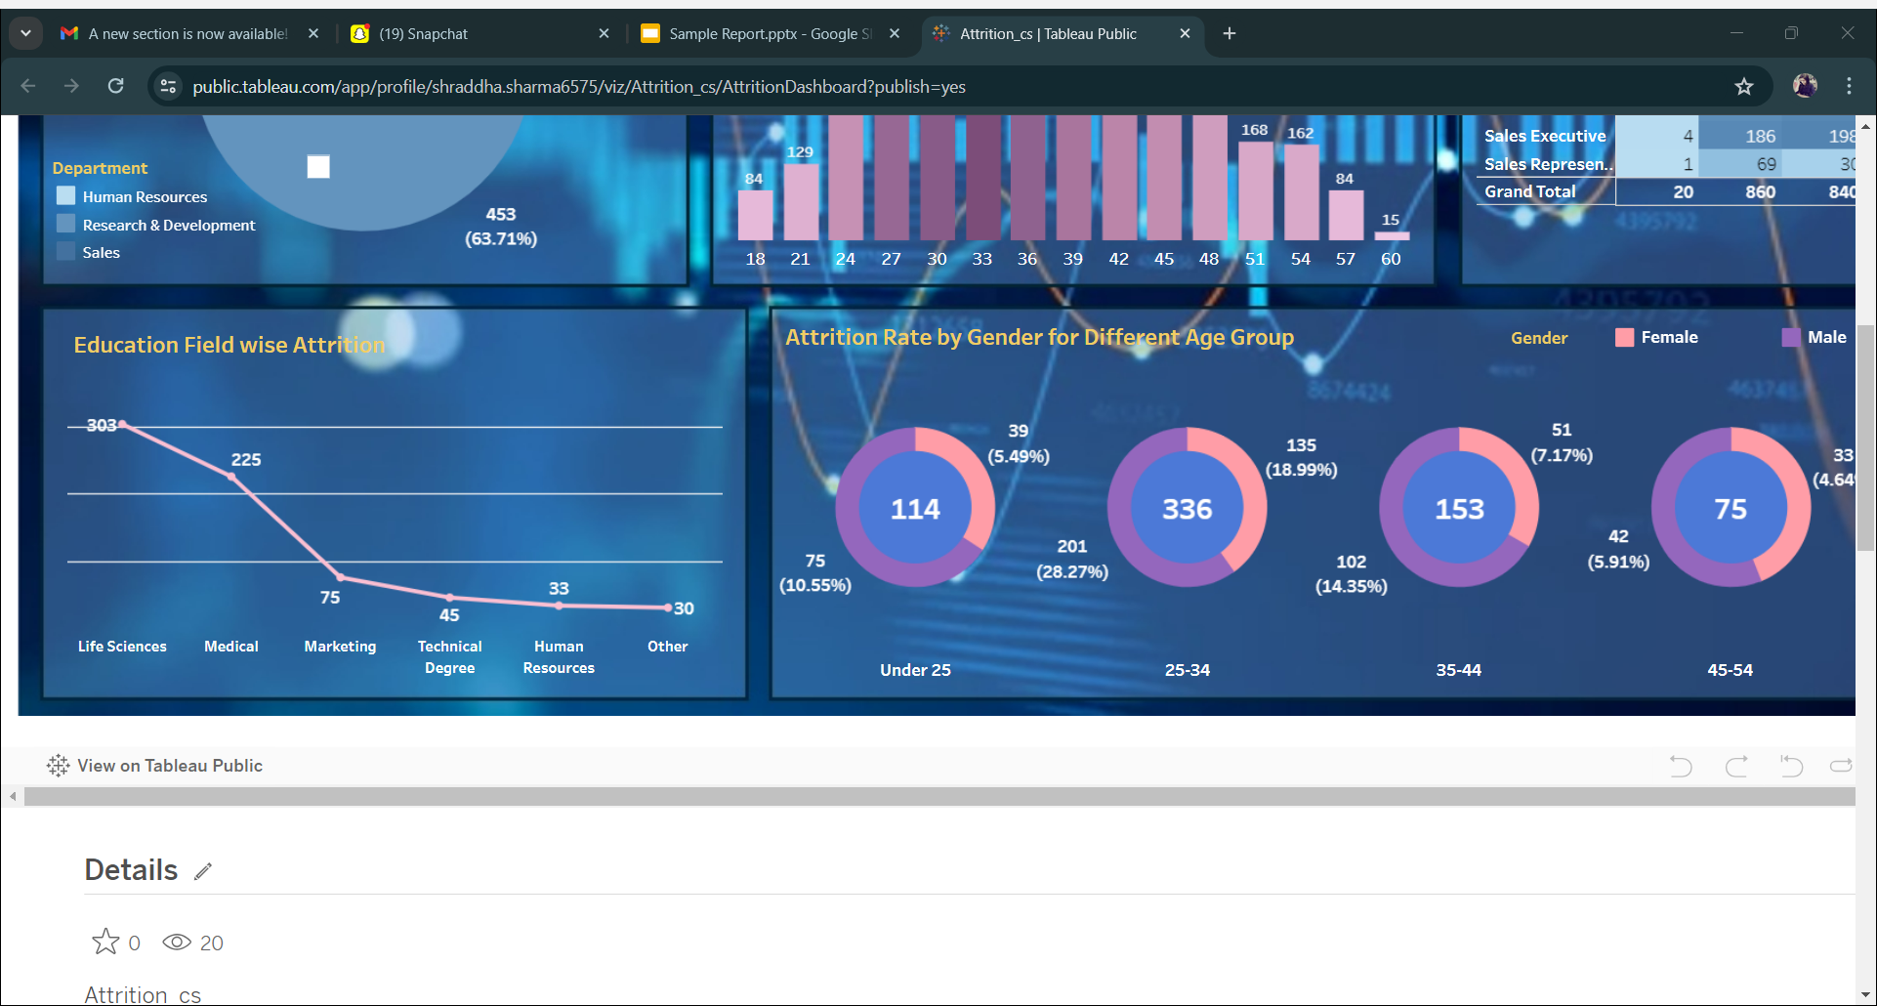
Department wise attrition
EDUCATION FIELD WISE ATTRITION

Slide 9
aNALYSIS
DEOARTMENT WISE ATTRITION - Research and Development department is experiencing the highest attrition rate at 63.71%
GENDER WISE ATTRITION - Male employees have the higher attrition count than Female
ATTRITION RATE BY GENDER BY DIFFERENT AGE GROUP - Across all age groups, male attrition rates consistently trend higher. Notably, the age group between 25 to 34 experienced the highest attrition, with male attrition peaking at 28.27%.
EDUCATION FIELS WISE ATTRITION - Life Science exhibits the highest attrition at 303, followed by Medical at 225, Marketing at 75, Technical Degree at 45, Human Resources at 33, and Other fields at 30.

Slide 10
THANK YOU

